Slide 1


Munich Companion
Lucas Hercog- Technical Universität München
Thomas Wittmann-Technical Universität München
Martin Dambach-Technical Universität München
Deep Saha-Universität des Saarlandes

Slide 2
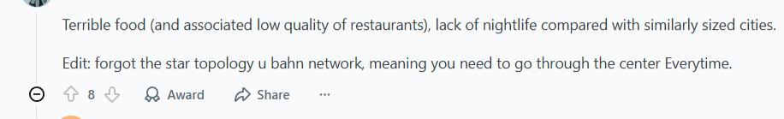
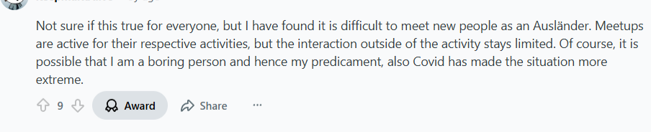
Problems!!
2
1
3

Slide 3
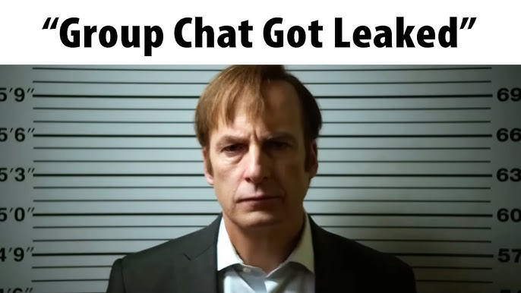
Man-in-the-middle (MITM) risk
Client ↔ Server ↔ Client model
3.
2.
1.
Every Step in Munich
No way to verify message authenticity
What is Winter Depression?? We PARTYYY!!!
Messages were often stored unencrypted
2
1
3

Slide 4
Man-in-the-middle (MITM) risk
Client ↔ Server ↔ Client model
3.
2.
Every Step in Münich
1.
Lonely??
Taking a chill pill??
What is Winter Depression?? We PARTYYY!!!
2
1
3

Slide 5
Man-in-the-middle (MITM) risk
Client ↔ Server ↔ Client model
1.
2.
3.
Every Step in Munich
Lonely??
No user control over encryption keys
Lonely
2
1
3

Slide 6
Man-in-the-middle (MITM) risk
Client ↔ Server ↔ Client model
1.
2.
3.
Every Step in Münich
Lonely??
No user control over encryption keys
Lonely
2
1
3

Slide 7



Diffie-Hellman key exchange basics
Only sender and receiver have decryption keys
E2EE prevents server from reading messages
I have no Friends

Slide 8
Age filtered groups
Crazy Groups to be part of
New Friends, Yayyy!!!
I have no Friends

Slide 9
I have no Friends
Crazy Groups to be part of
Age filtered groups
New Friends, Yayyy!!!

Slide 10


Man-in-the-middle (MITM) risk
1
2
3.
Messages were often stored unencrypted. So server could read modify or forge messages.
No way to verify message authenticity
ALICE

Slide 11
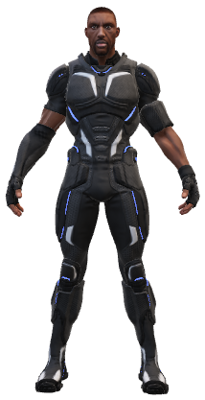
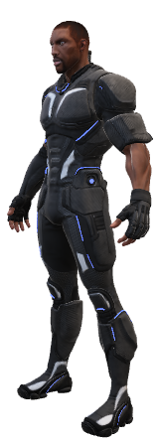
AMAZING GROUPS of MÜNCHEN
ALICE
BOB
GROUP
BOB

Slide 12
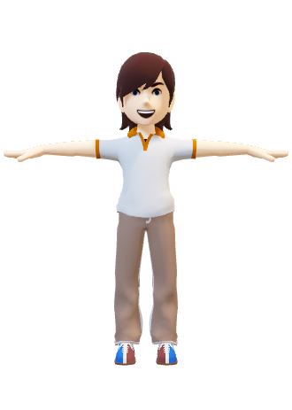

AMAZING GROUPS of MÜNCHEN
ALICE
BOB
Jake
GROUP
BOB

Slide 13
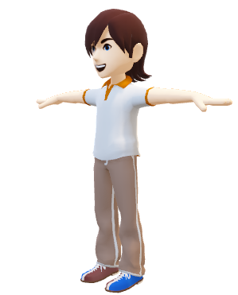
FRIEND
AMAZING GROUPS of MÜNCHEN
ALICE
BOB
Jake
ALICE
GROUP
BOB

Slide 14
AMAZING GROUPS of MÜNCHEN
FRIEND
ALICE
BOB
Jake
ALICE
GROUP
BOB

Slide 15

Diffie-Hellman key exchange basics
But Im lazy af
companion helps you socialize

Slide 16
But Im lazy af
companion helps you socialize

Slide 17

companion helps you socialize
But Im lazy af
not just information, but fun facts

Slide 18
companion to help you chill
But Im lazy af
not just information, but fun facts

Slide 19

companion helps you socialize
not just information, but fun facts
But I’m lazy af
Explore Münich

Slide 20
companion to help you chill
not just information, but fun facts
But Im lazy af
Explore Münich

Slide 21
CONIKS — A First Attempt to Fix This
companion to help you chill
not just information, but fun facts
Explore Munich
But Im lazy af

Slide 22

Future Aspects
Key authenticity isn’t guaranteed
You still trust the server to give you the right key
MITM attack possible during key delivery
Mobile App with pop up notifications
Matching people based on interests
But E2EE Has a
Problem...
What CONIKS introduced (verifiable key directories)
Merkle trees
- Epochs
- Consistency checks.
But… clients must be online & no privacy for lookups

Slide 23
THANKS!

